Slide 1
Task3: Rewrite the program given in the “Java Networking Slides” where single client and server are presenting a scenario of chatting. Your program should introduce two clients to chat. Implement one server that serves both the clients.
Case | Input | Output | Result
Normal case | Step1. run chat server and client Run java ca.jay.jac444.workshop4.EchoServer 3333 Run java ca.jay.jac444.workshop4.EchoClient 3333 Run java ca.jay.jac444.workshop4.EchoClient 3333 Step2. in one client, enter the name ‘ali’ Step3. in another client, enter the name ‘mahboob’ Step4. client ‘ali’ text to server with message: hi how are you? Step5. client ‘mahboob’ text to server with message: i am fine and text again with How are you? | In server, display like: MultiThreadServer started at Thu Dec 14 04:53:15 EST 2017 Connection from Socket[addr=/127.0.0.1,port=57327,localport=8000] at Thu Dec 14 04:53:36 EST 2017 Connection from Socket[addr=/127.0.0.1,port=57328,localport=8000] at Thu Dec 14 04:54:34 EST 2017 ali: hi how are you? mahboob: i am fine mahoob: How are you? In client1, display like: Enter you name: ali Enter Text: hi how are you? Enter Text: In client2, display like: Enter you name: mahboob Enter Text: i am fine Enter Text: How are you? Enter Text: | OK

Slide 2
Case | Input | Output | Result
2. Missing command-line argument for port | Run java ca.jay.jac444.workshop4.EchoServer Run java ca.jay.jac444.workshop4.EchoClient | It needs a command-line arguments for a port | OK
3. Client try to connect while sever is not open | Run java ca.jay.jac444.workshop4.EchoClient 3333 | The connection is failed. Please check your environment ex) host, port etc | OK
4. Client try to connect with different port form sever port | Run java ca.jay.jac444.workshop4.EchoServer 3333 Run java ca.jay.jac444.workshop4.EchoClient 2222 | The connection is failed. Please check your environment ex) host, port etc | OK
5. Stop the client app | Run java ca.jay.jac444.workshop4.EchoServer 3333 Run java ca.jay.jac444.workshop4.EchoClient 3333 Input ‘stop’ keyword | Display ‘stop’ in server, and stop the client program | OK

Slide 3
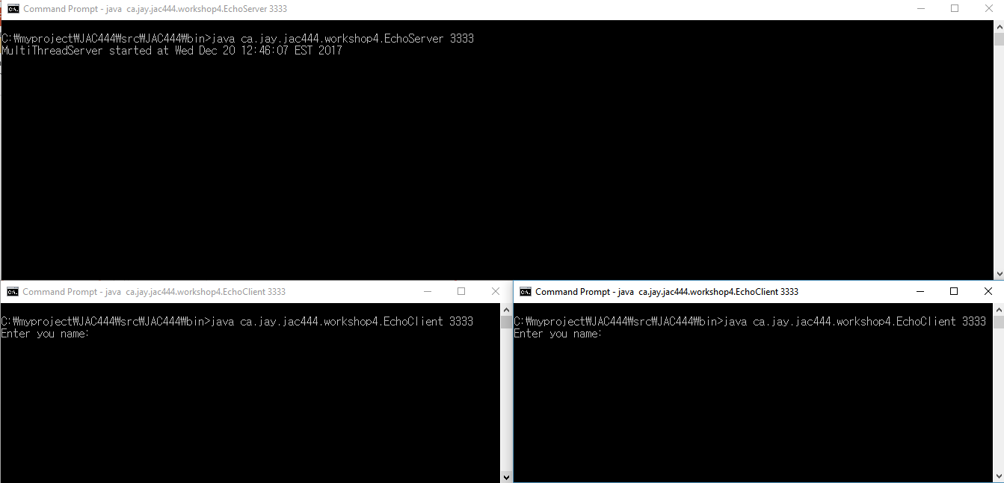
Case1. Normal case:
Step1. run chat server and client: Run java ca.jay.jac444.workshop4.EchoServer 3333,
Run java ca.jay.jac444.workshop4.EchoClient 3333, Run java ca.jay.jac444.workshop4.EchoClient 3333
Open the server
Open the client1
Open the client2

Slide 4
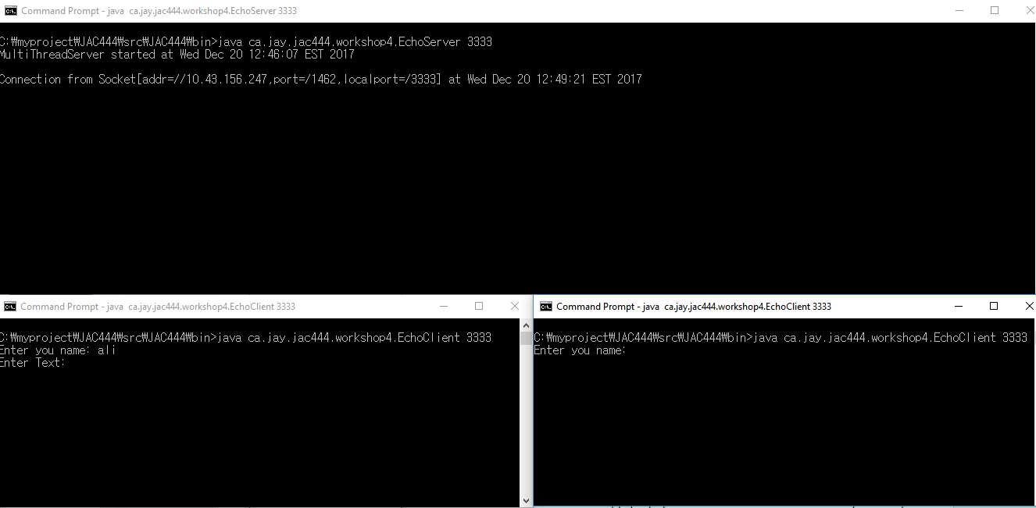
Case1. Normal case:
Step2. in one client, enter the name ‘ali
Display the connection message form client1
Connect form client1 to server

Slide 5
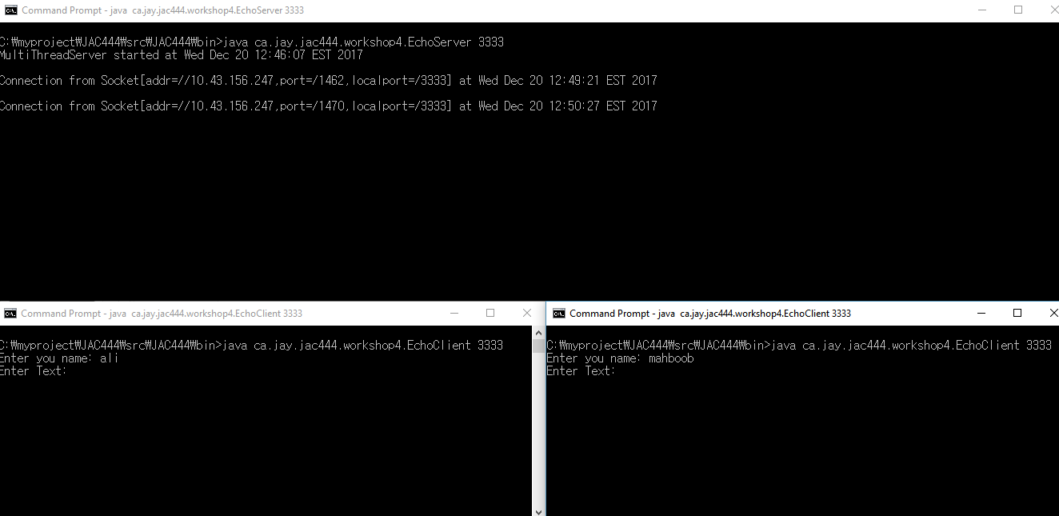
Case1. Normal case:
Step3. in another client, enter the name ‘mahboob’
Display the connection message form client1
Connect form client2 to server

Slide 6
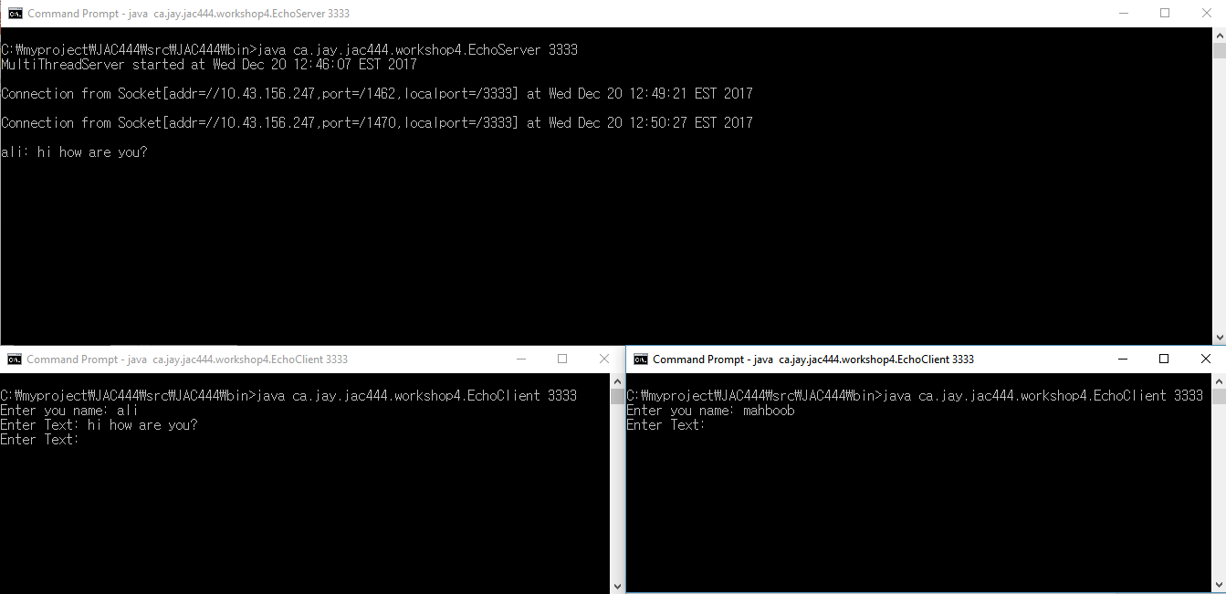
Case1. Normal case:
Step4. client ‘ali’ text to server with message: hi how are you?
Display the text form client1
text form client1 to server

Slide 7
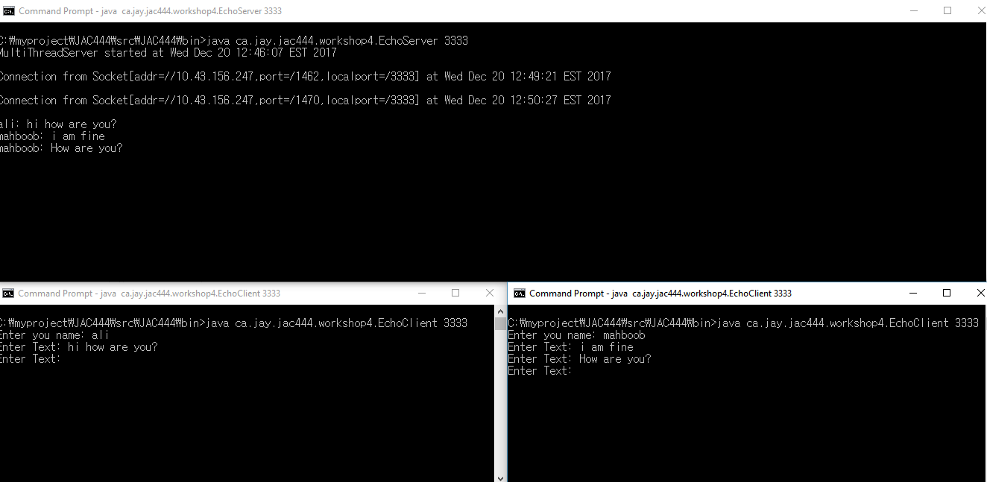
Case1. Normal case:
Step5. client ‘mahboob’ text to server with message: i am fine and text again with How are you?
Display the text form client1
Error message is displayed
text form client2 to server

Slide 8
Case1. Normal case:
Check all messages of server and client
All displayed messages are the same to the scenario
Error message is displayed

Slide 9
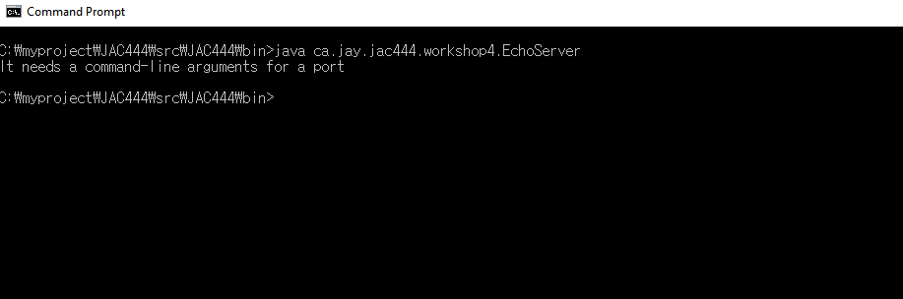
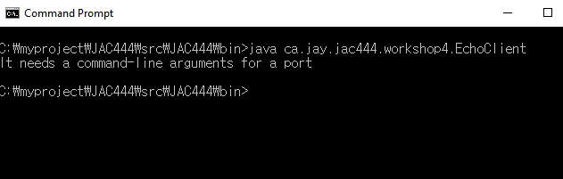
Case2. Missing command-line argument for port:
Run java ca.jay.jac444.workshop4.EchoServer, Run java ca.jay.jac444.workshop4.EchoClient
Check the message: “It needs a command-line arguments for a port”
Error message is displayed in server
Error message is displayed in client

Slide 10
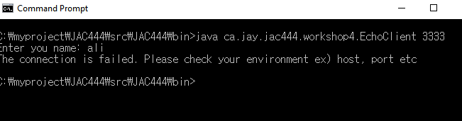
Case3. Client try to connect while sever is not open:
Run java ca.jay.jac444.workshop4.EchoClient 3333
Check the message: “The connection is failed. Please check your environment ex) host, port etc”
Server is not open
Error message is displayed in client

Slide 11
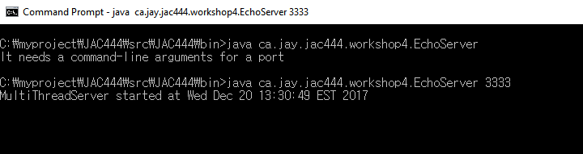
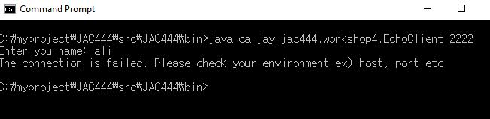
Case4. Client try to connect with different port from sever port:
Run java ca.jay.jac444.workshop4.EchoClient 3333, Run java ca.jay.jac444.workshop4.EchoClient 2222
Check the message: “The connection is failed. Please check your environment ex) host, port etc”
Server is open in 3333 port
Error message is displayed in client

Slide 12
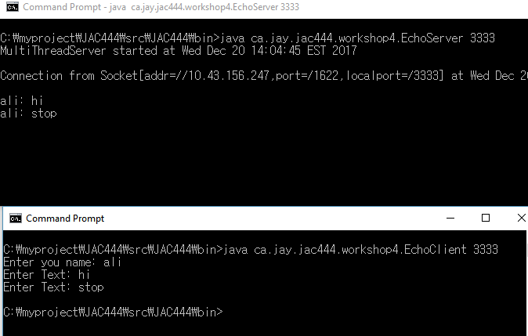
Case5. Stop the client app:
Run java ca.jay.jac444.workshop4.EchoClient 3333, Run java ca.jay.jac444.workshop4.EchoClient 3333
Check : Display ‘stop’ in server, and stop the client program
Display ‘stop’ in server
stop the client program

